Slide 1
COLLABORATIVE SONG RECOMMENDATION SYSTEM USING NEO4J

Slide 2
CREATING NODES

Slide 3
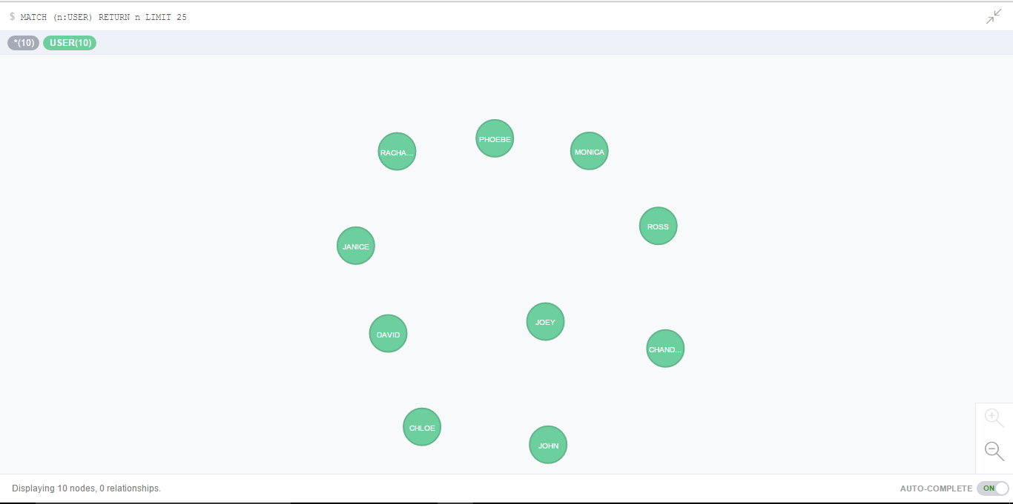
CREATING USER NODES

Slide 4
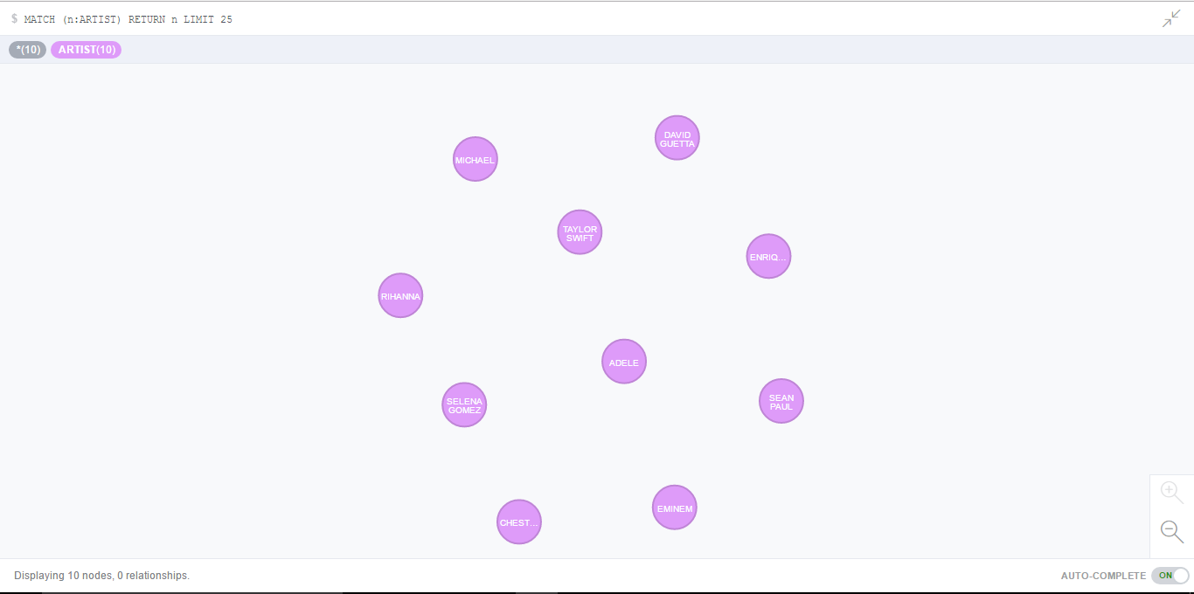
CREATING ARTIST NODES

Slide 5
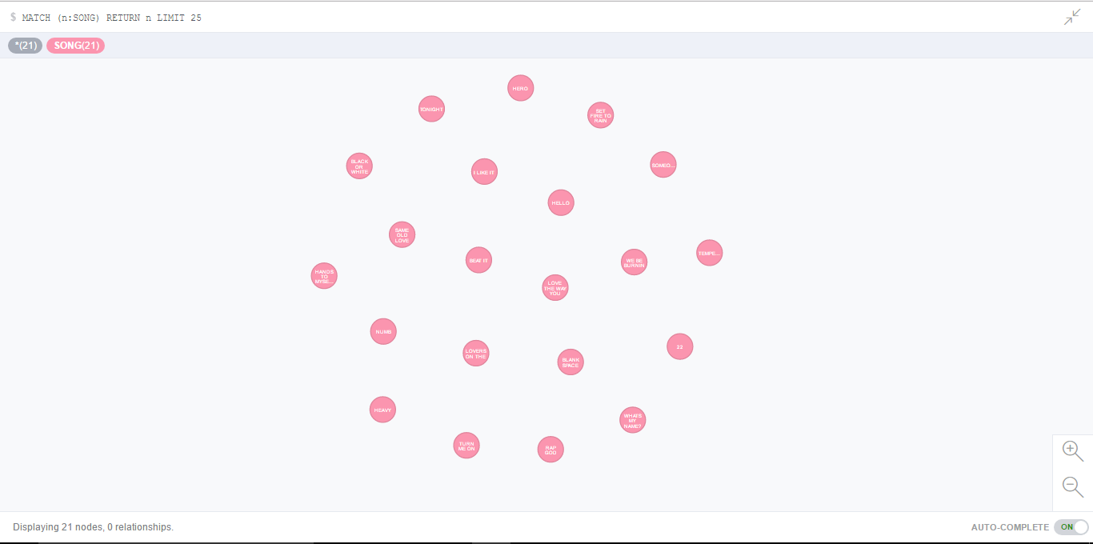
CREATING SONG NODES

Slide 6
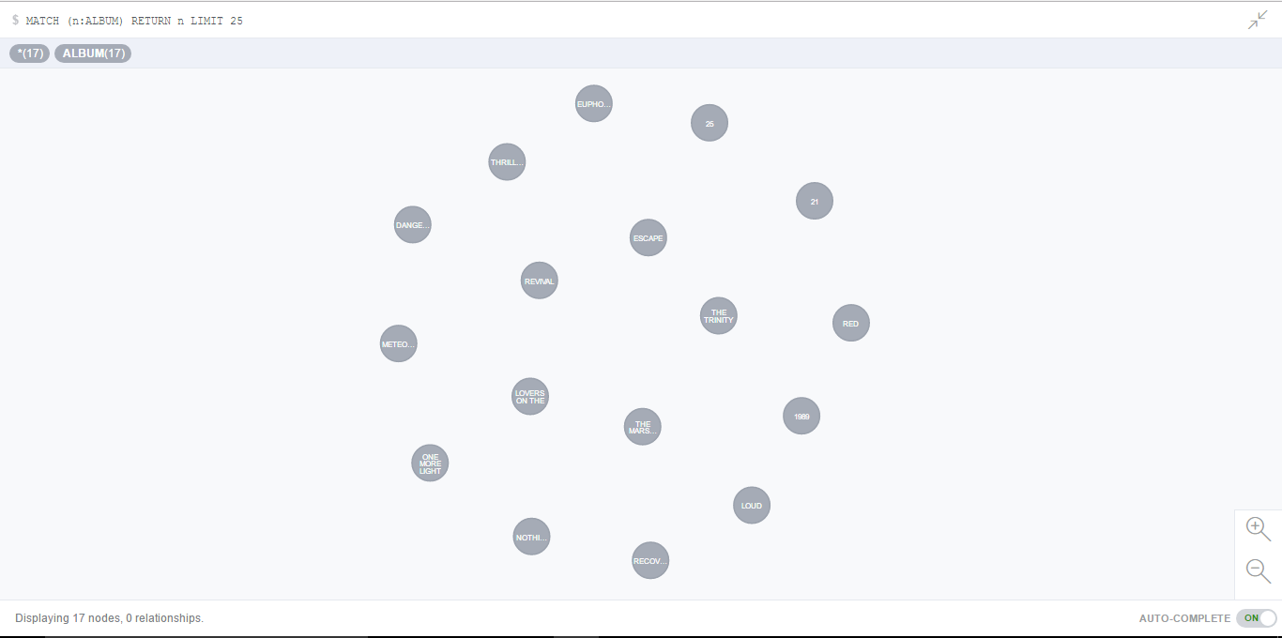
CREATING ALBUM NODES

Slide 7
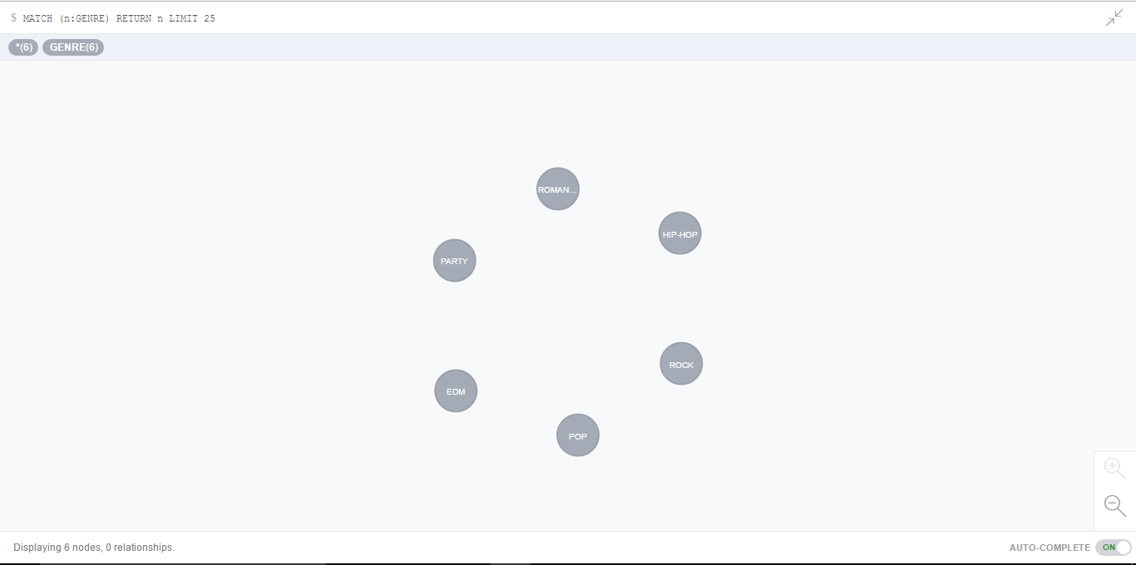
CREATING GENRE NODES

Slide 8
CREATING RELATIONSHIPS

Slide 9
VARIOUS RELATIONSHIPS
Song – [:SUNG_BY] -> Artist
Song - [:IS_OF] -> Album
Song - [:BELONGS_TO] -> Genre
User - [:LISTENS] -> Song
User - [:LIKES] -> Album
User - [:FOLLOWS] -> Artist
User - [:FRIEND_OF] -> User
Album - [:IS_OF_TYPE] -> Genre
Album - [:RELEASED_BY] -> Artist

Slide 10
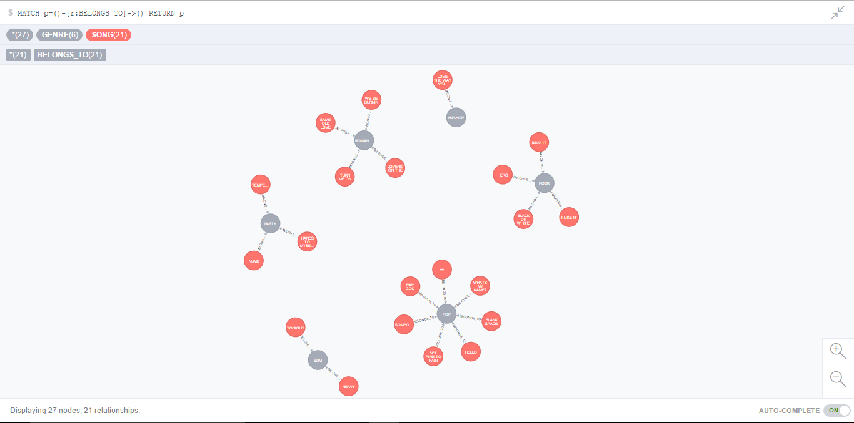
SONG - [:BELONGS_TO] -> Genre

Slide 11
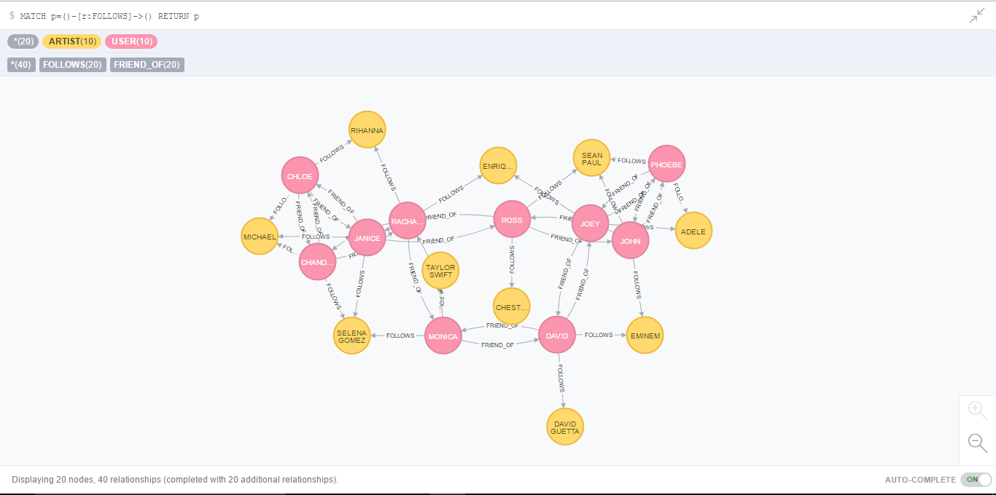
USER - [:FOLLOWS] -> Artist

Slide 12
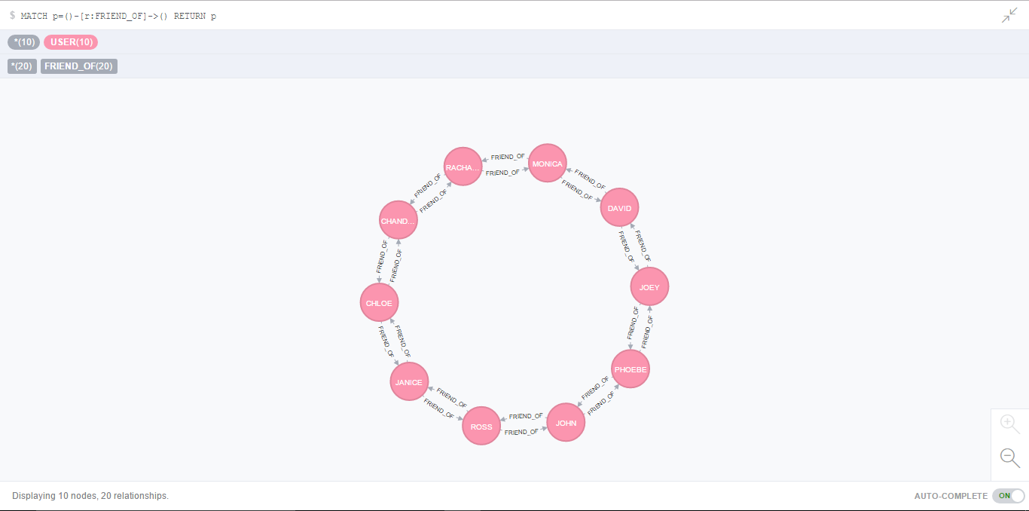
USER - [:FRIEND_OF] -> User

Slide 13
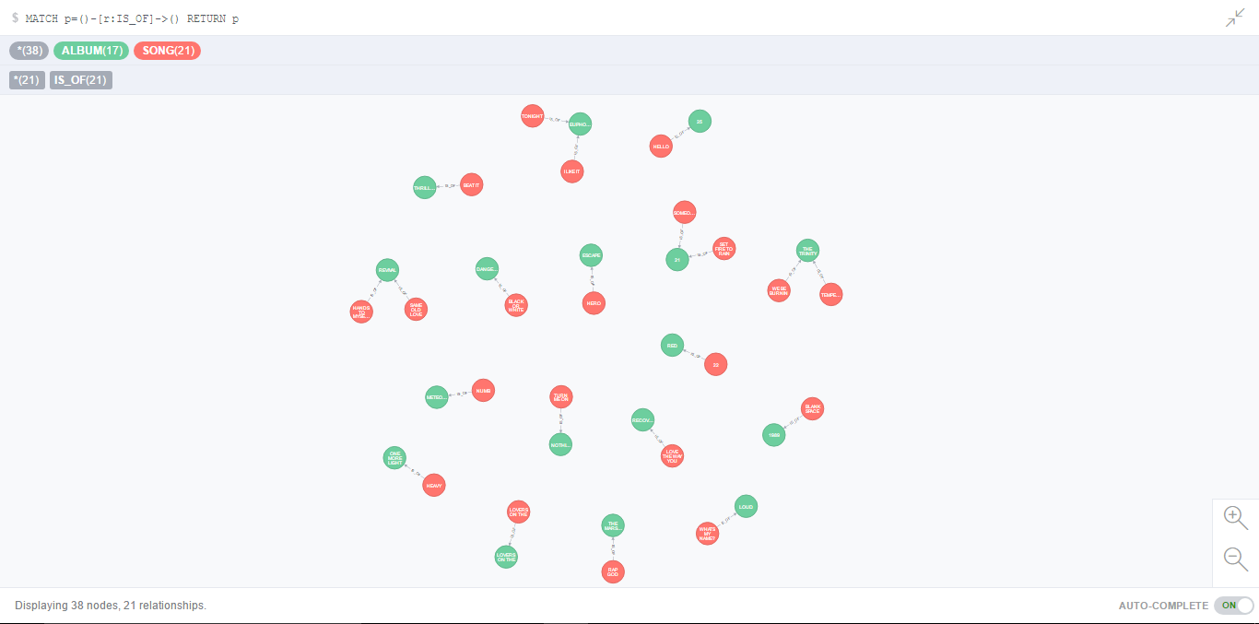
SONG - [:IS_OF] -> Album

Slide 14
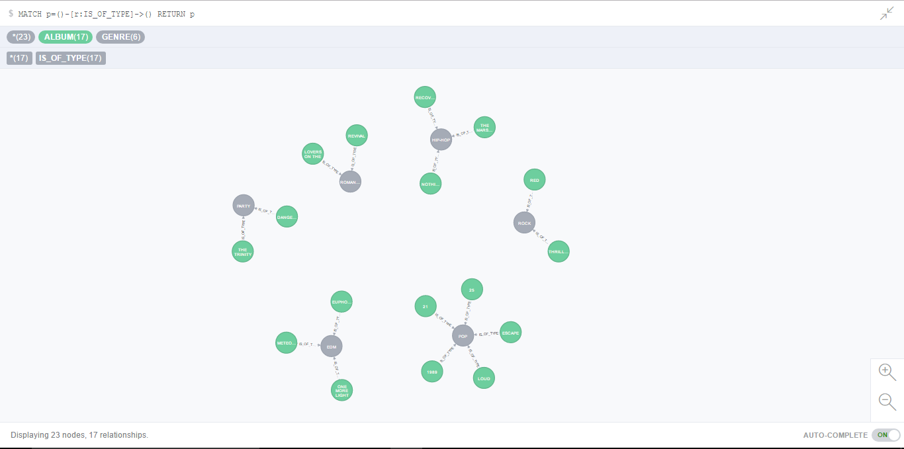
ALBUM - [:IS_OF_TYPE] -> Genre

Slide 15
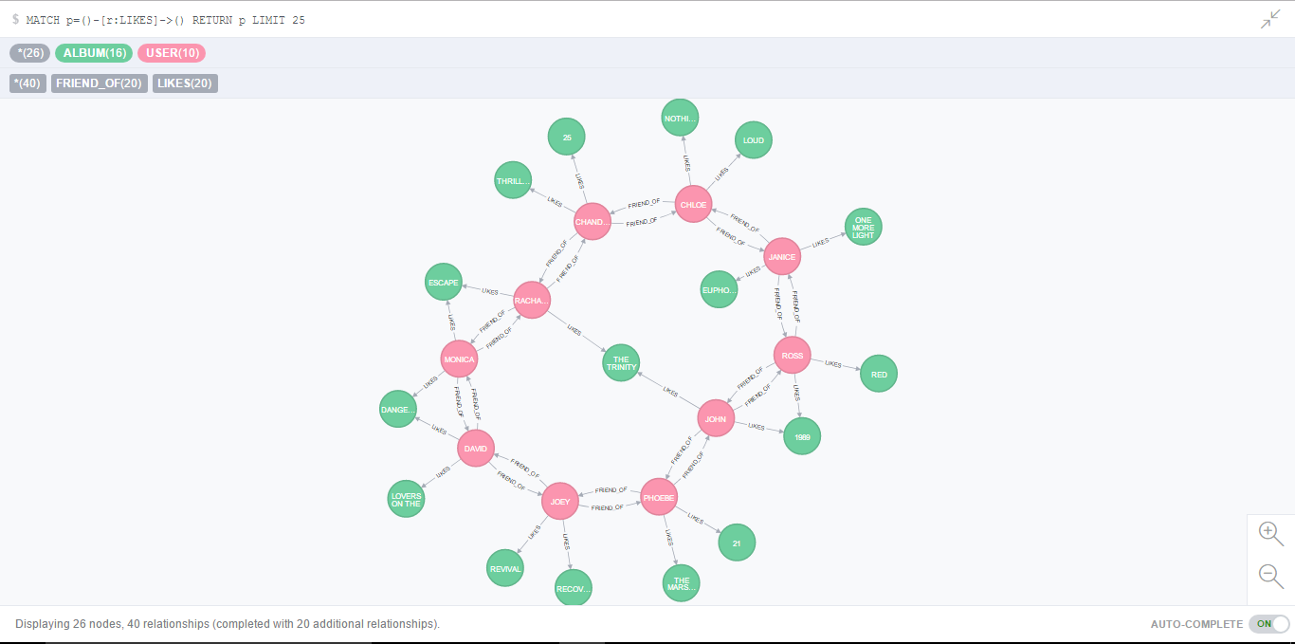
USER - [:LISTENS] -> Song

Slide 16
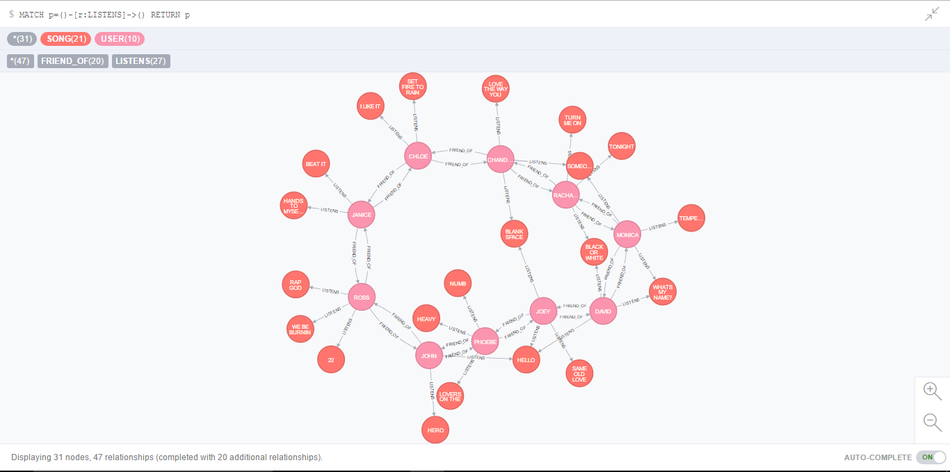
USER - [:LISTENS] -> Song

Slide 17
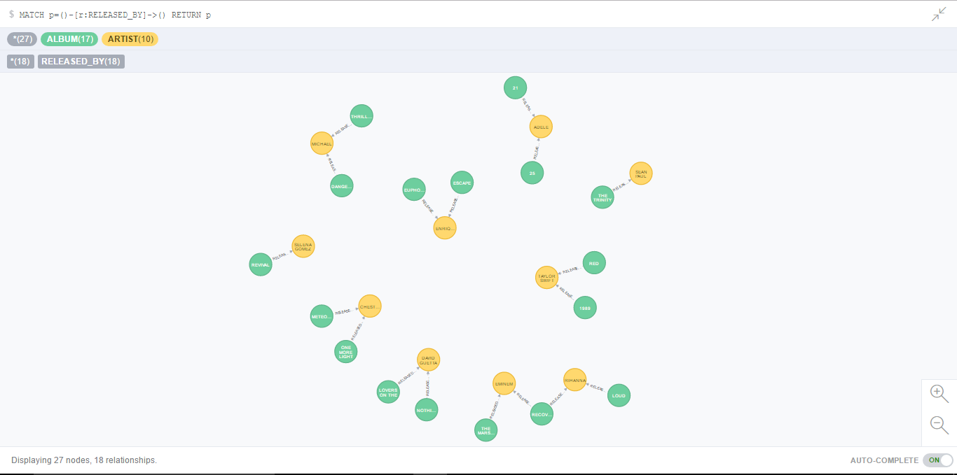
ALBUM - [:RELEASED_BY] -> Artist

Slide 18
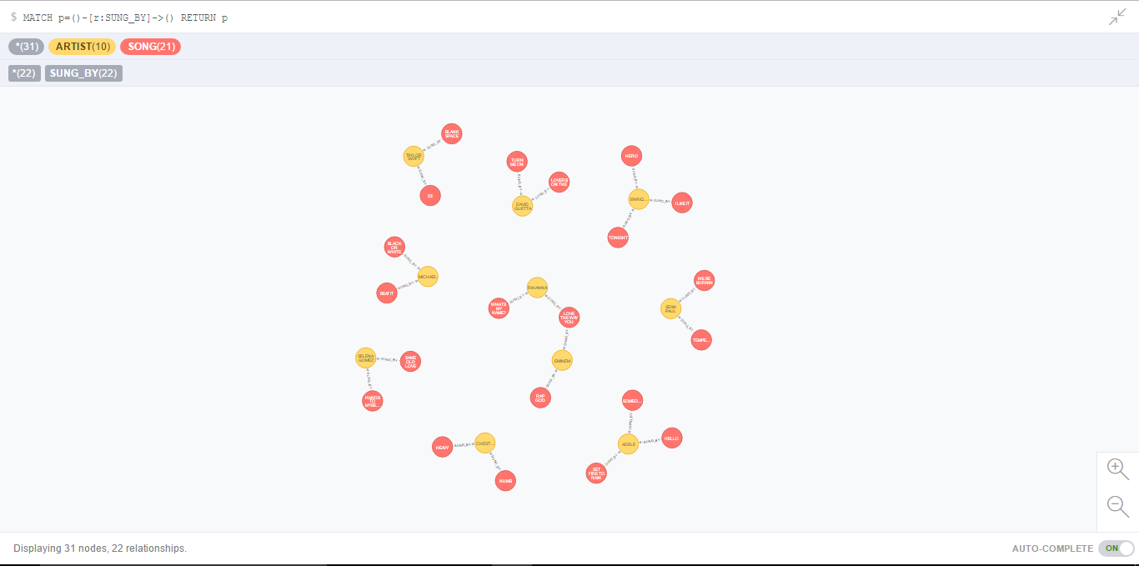
SONG – [:SUNG_BY] -> Artist

Slide 19
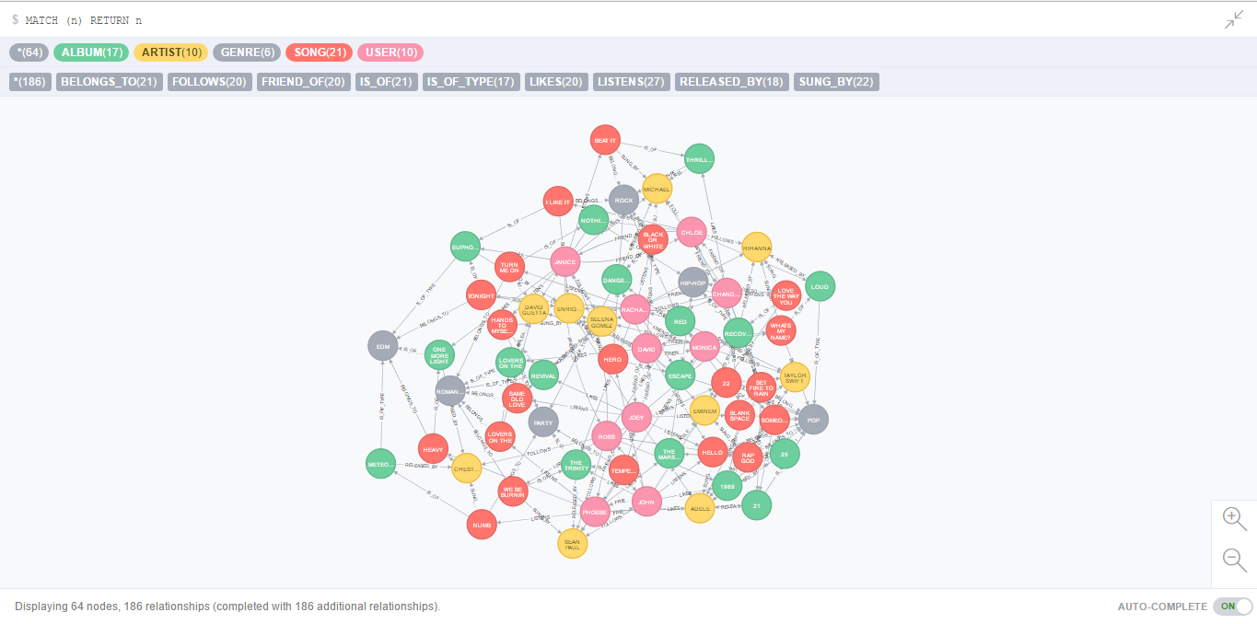
THE OVERALL GRAPH

Slide 20
QUERIES

Slide 21
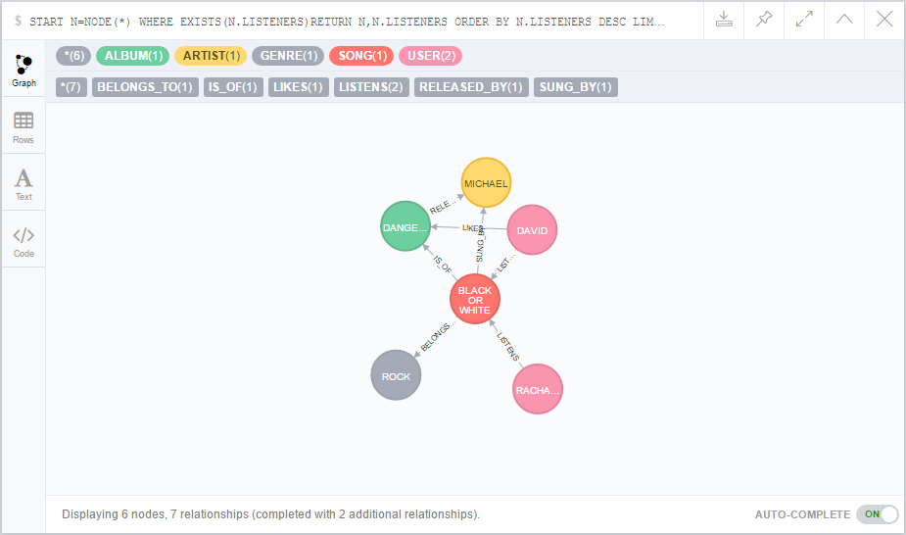
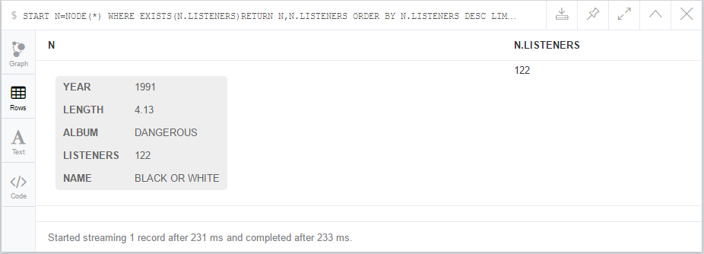
MOST POPULAR SONG START N=NODE(*) WHERE EXISTS(N.LISTENERS) RETURN N, N.LISTENERS ORDER BY N.LISTENERS DESC LIMIT 1

Slide 22
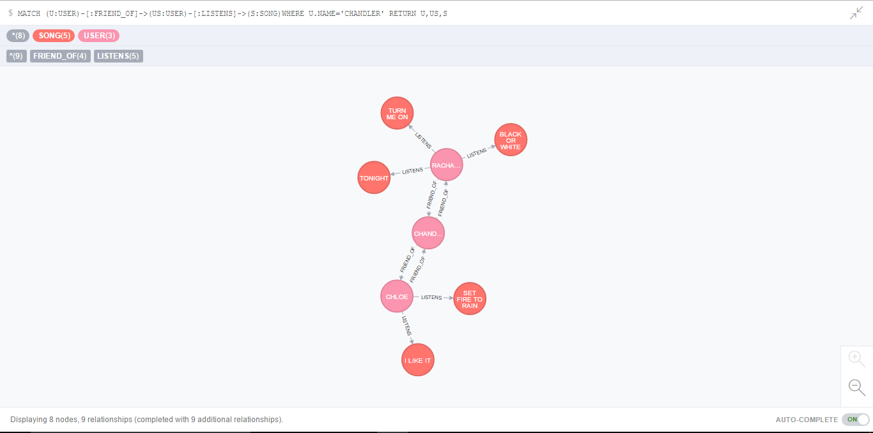
1 STEP RECOMMENDATION

Slide 23
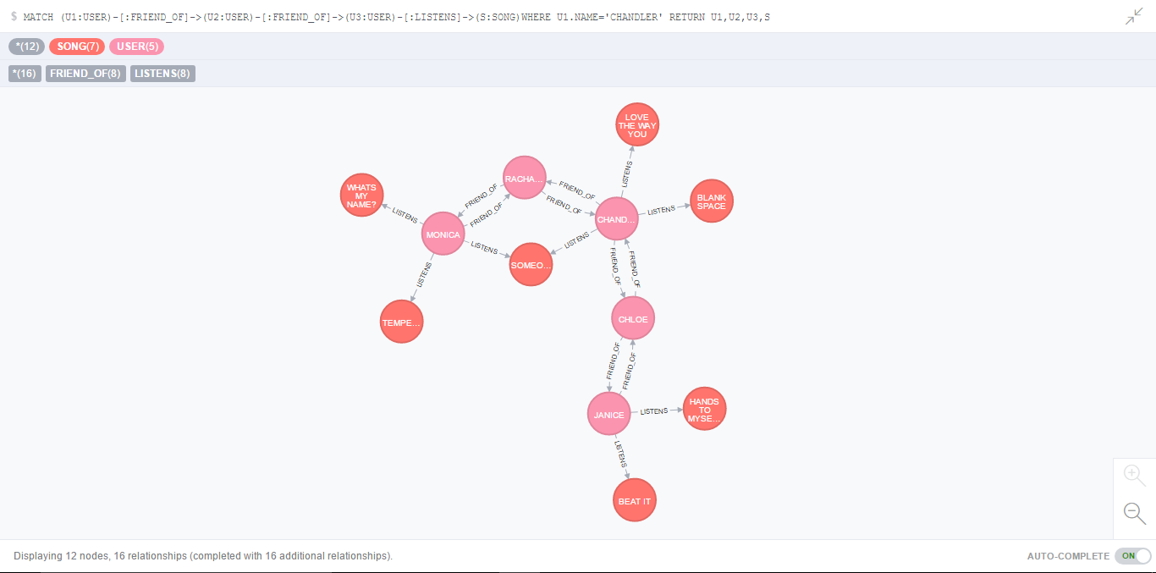
2 STEP RECOMMENDATION

Slide 24
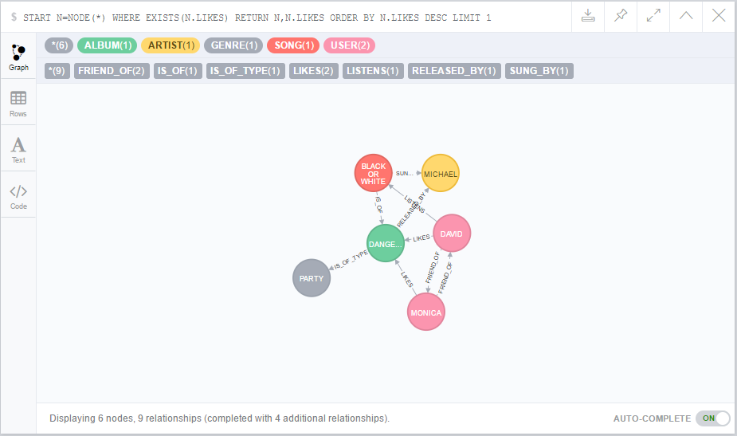
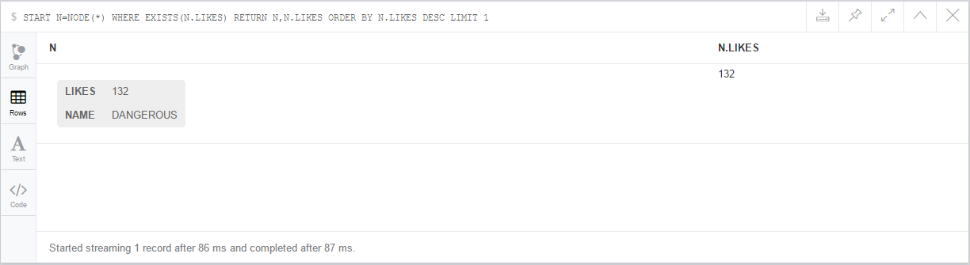
MOST FAMOUS ALBUM START N=NODE(*) WHERE EXISTS(N.LIKES) RETURN N,N.LIKES ORDER BY N.LIKES DESC LIMIT 1

Slide 25
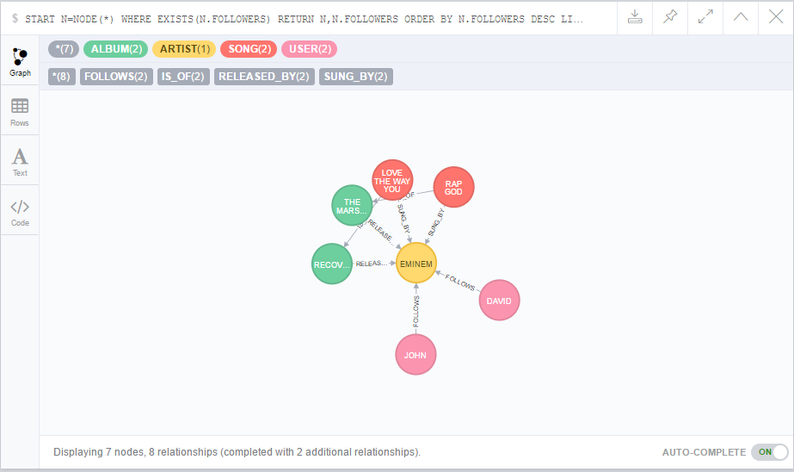
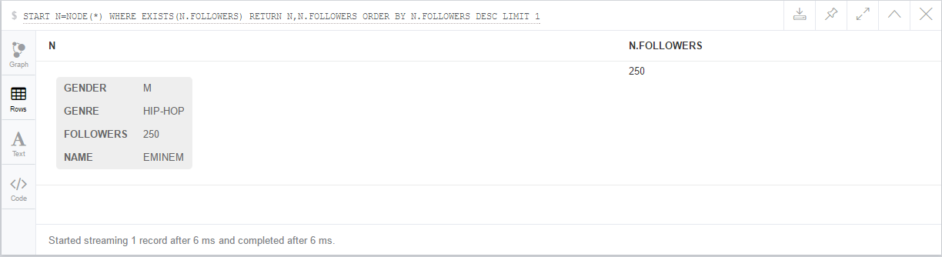
MOST FAMOUS ARTIST START N=NODE(*) WHERE EXISTS(N.FOLLOWERS) RETURN N,N.FOLLOWERS ORDER BY N.FOLLOWERS DESC LIMIT 1

Slide 26
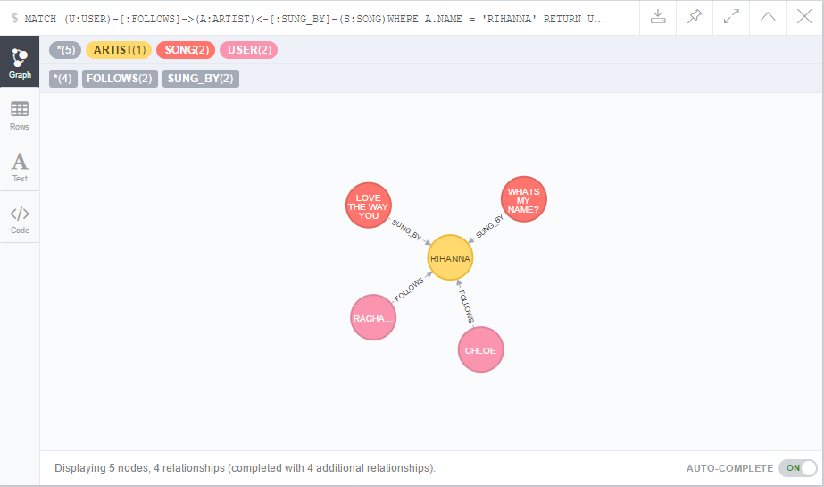
SONGS FROM A SPECIFIC ARTIST

Slide 27
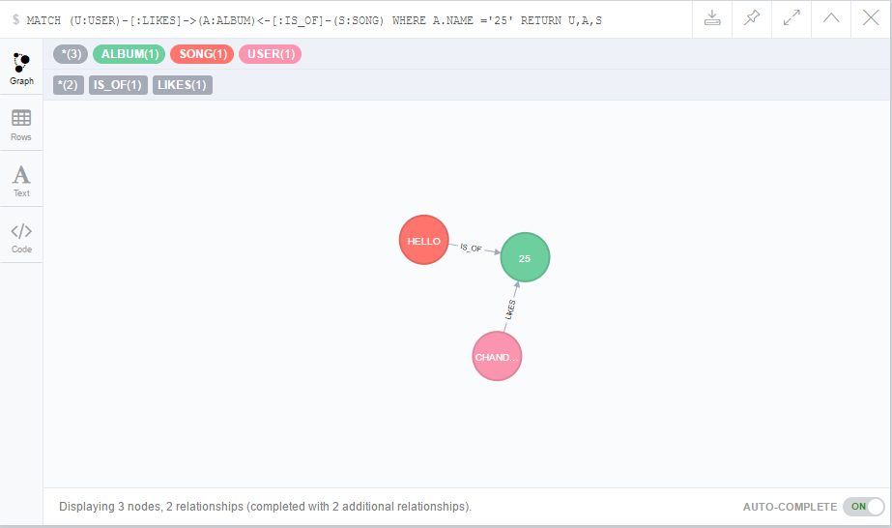
SONGS FROM A SPECIFIC ALBUM

Slide 28
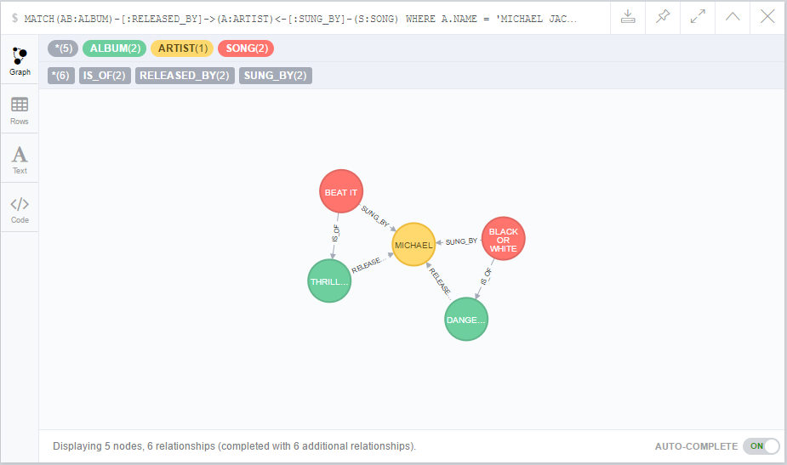
SONGS FROM ALBUM OF A SPECIFIC ARTIST

Slide 29
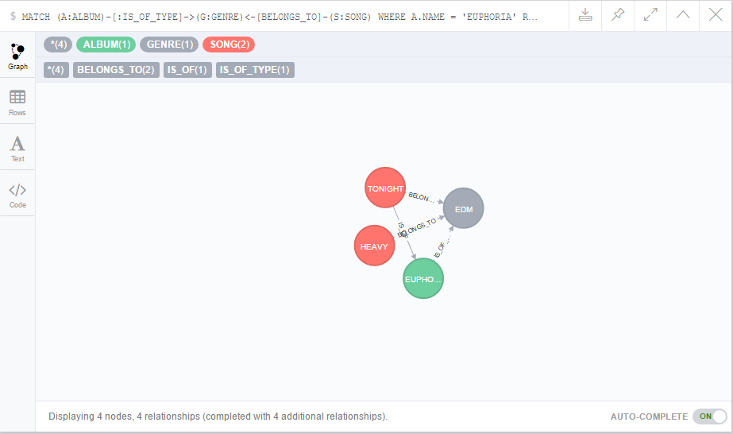
SONGS FROM THE GENRE OF A GIVEN ALBUM

Slide 30
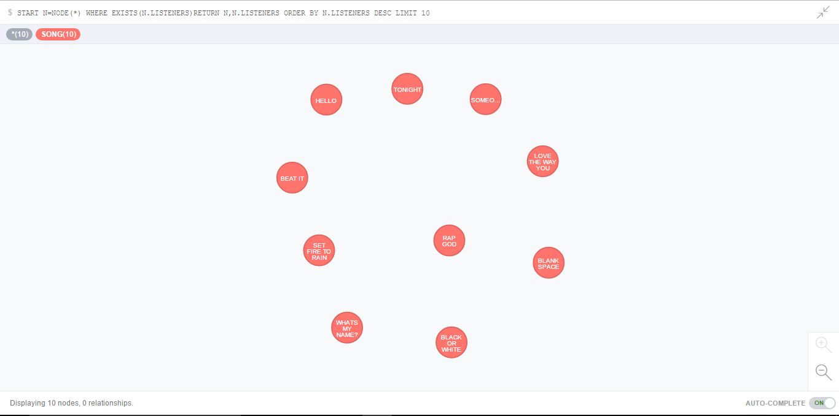
TOP 10 LIST OF SONGS

